Slide 1
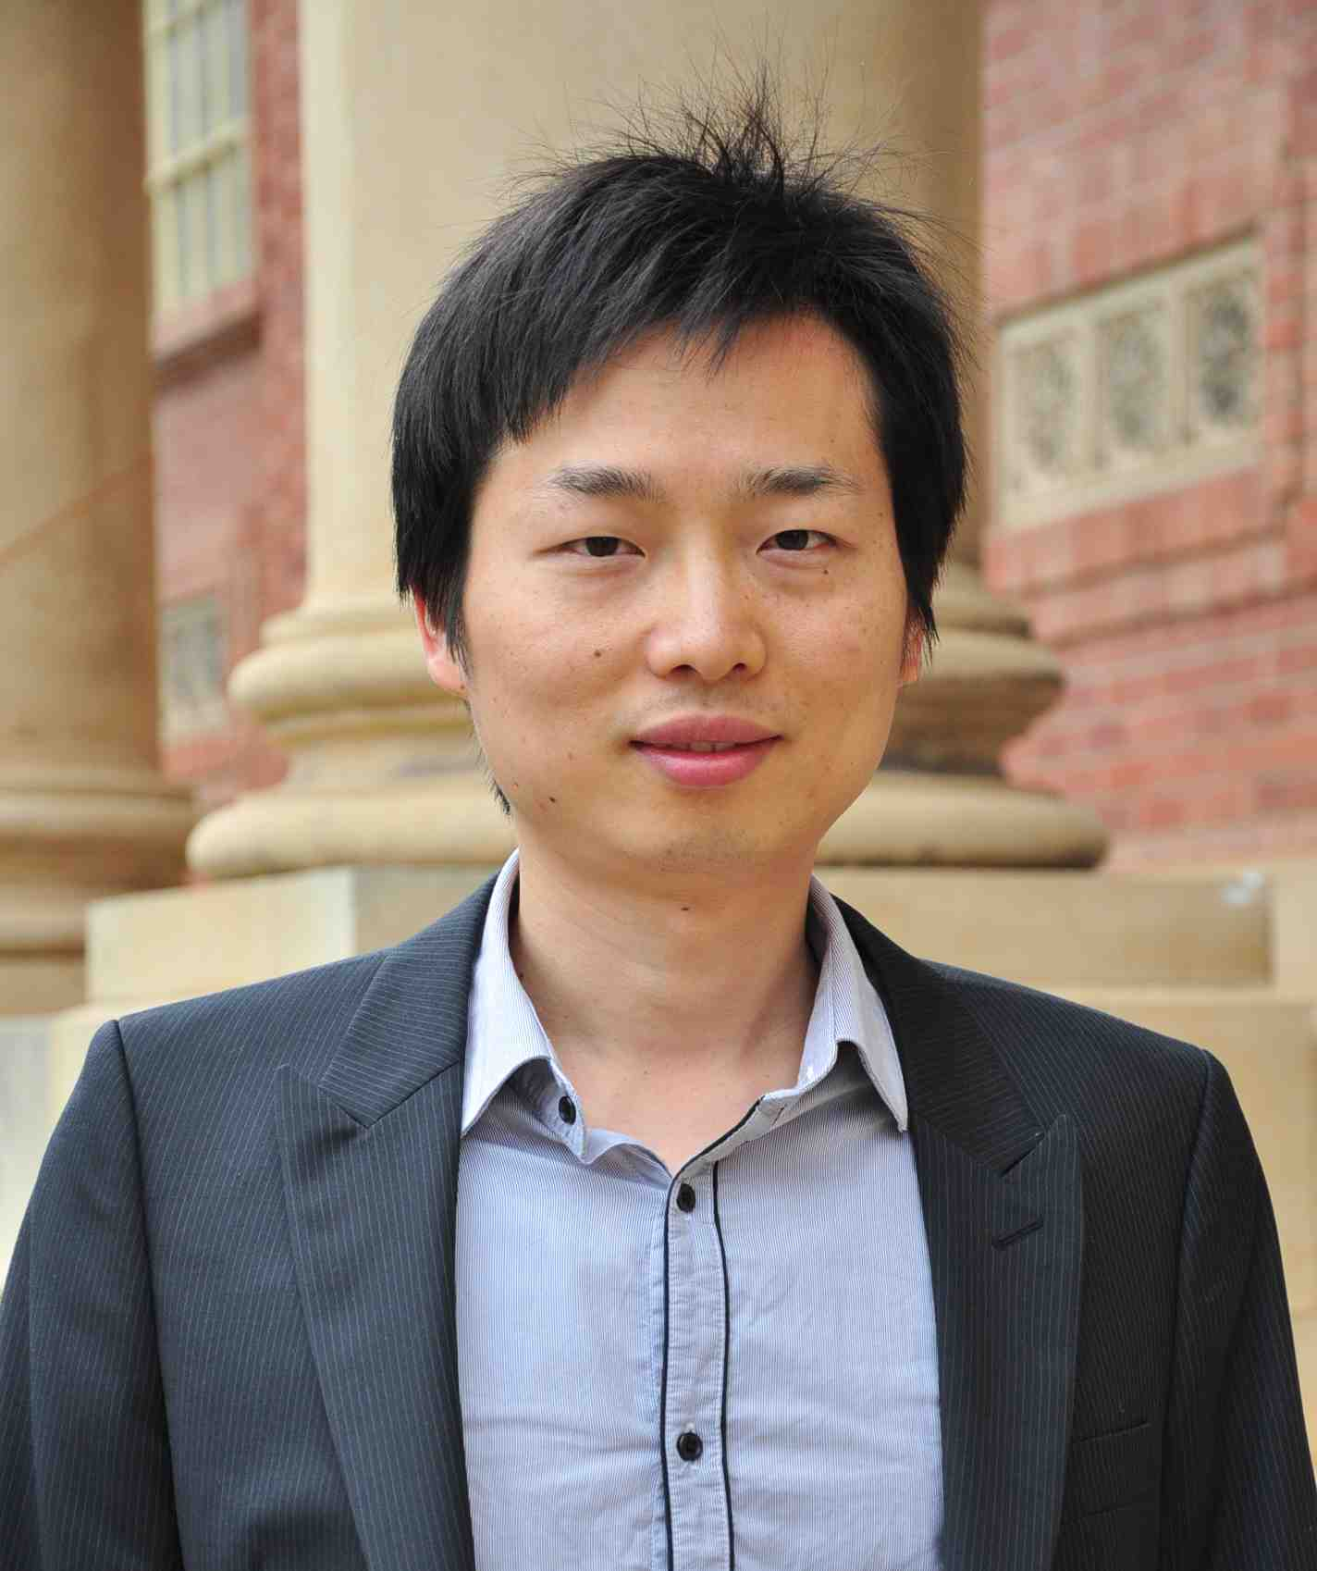
GMCV 2014 International Workshop on Graphical Models in Computer Vision
7th September 2014, ECCV, Zurich
Michael Ying Yang, University of Hannover Qinfeng (Javen) Shi, University of Adelaide Sebastian Nowozin, Microsoft Research

Slide 2
Graphical Models in Computer Vision
09:10 – 10:10 Keynote: Vittorio Ferrari
10:10 – 10:35 Contributed talk: Varun Nagaraja, Vlad Morariu, Larry Davis
10:35 – 11:10 Coffee break
11:10 – 12:10 Keynote: Raquel Urtasun
12:10 – 14:00 Lunch break
14:00 – 15:00 Keynote: Joerg Hendrik Kappes
15:00 – 15:25 Contributed talk: Cheng Zhang, Hedvig Kjellstroem
15:25 – 16:00 Coffee break
16:00 – 17:00 Keynote: Pushmeet Kohli
17:00 – 17:25 Contributed talk: Nathan Silberman, David Sontag, Rob Fergus
17:25 – 17:50 Contributed talk: Joerg H. Kappes, Thorsten Beier, Christoph Schnörr

Slide 3
Thanks
Participants of the workshop and authors of the papers!
Keynote speakers
Vittorio Ferrari, Raquel Urtasun, Joerg Hendrik Kappes, Pushmeet Kohli
Program Committee
Dhruv Batra, Tiberio Caetano, Yutian Chen, Jason Corso, Justin Domke, Stephen Gould, Xuming He, Alexander Ihler, Jeremy Jancsary, Joerg Kappes, Vladimir Kolmogorov, Christoph Lampert, Julian McAuley, Chris Russell, Bogdan Savchynskyy, Alexander Schwing, Danny Tarlow, Raquel Urtasun, Olga Veksler, Tomas Werner, Xinhua Zhang
Sponsors
Computer Vision Foundation
Microsoft Research

Slide 4
Recent Trends
(in eight pieces, from conservative to radical)

Slide 5
Linear Programming based Inference
Empirical evidence of good performance
Energy Minimization study (Kappes et al., 2013)
Theory is “done”
Precise characterization of language (set of energy functions) that yield tight LOCAL relaxations (Thapper and Živný, 2012), (Kolmogorov et al., 2013), (Thapper and Živný, 2013)
Solving the LOCAL relaxation is as hard as solving an arbitrary linear program (Průša and Werner, 2013)
Robust implementations are now available
Generalized TRW-S (Schoenemann and Kolmogorov, 2014)
AD3 (Martins, 2012)
OpenGM, OpenGM2 (Andres, Beier, Kappes, 2012)
Improved primal solution recovery (Savchynskyy and Schmidt, 2014)

Slide 6
Structured SVM
Used to be a painful part of learning, but now
Frank-Wolfe based optimization for Structural SVMs (Lacoste-Julien, Jaggi, et al., 2013) Best of all worlds: iteration complexity of primal stochastic subgradient method explicit duality gap stopping criterion simpler to implement than cutting plane approaches
More efficient stochastic subgradient methods (Lacoste-Julien et al., 2012), (Shamir and Zhang, 2013)
Even more efficiency using caching of oracle calls (Shah et al., 2014)

Slide 7
Simultaneous optimization
Loss-augmented inference problem
Structured SVM
Energy
minimization
Classic: separation of estimation problem from the inference problem.
Now: removing this separation
Single joint optimization problem over inference messages and learning parameters (Meshi et al., 2010), (Hazan and Urtasun, 2010)
Also enables non-linearly parametrized potentials (Domke, 2014)

Slide 8
Multiple/diverse predictions
More than one prediction
k-best MAP (Fromer and Globerson, 2009), outstanding student paper award
Greedy diversity (Batra et al., 2012), explicitly demanding diversity
Probable modes (Chen et al., 2013)
Structured prediction with multiple outputs (Guzman-Rivera et al., 2012)

Slide 9
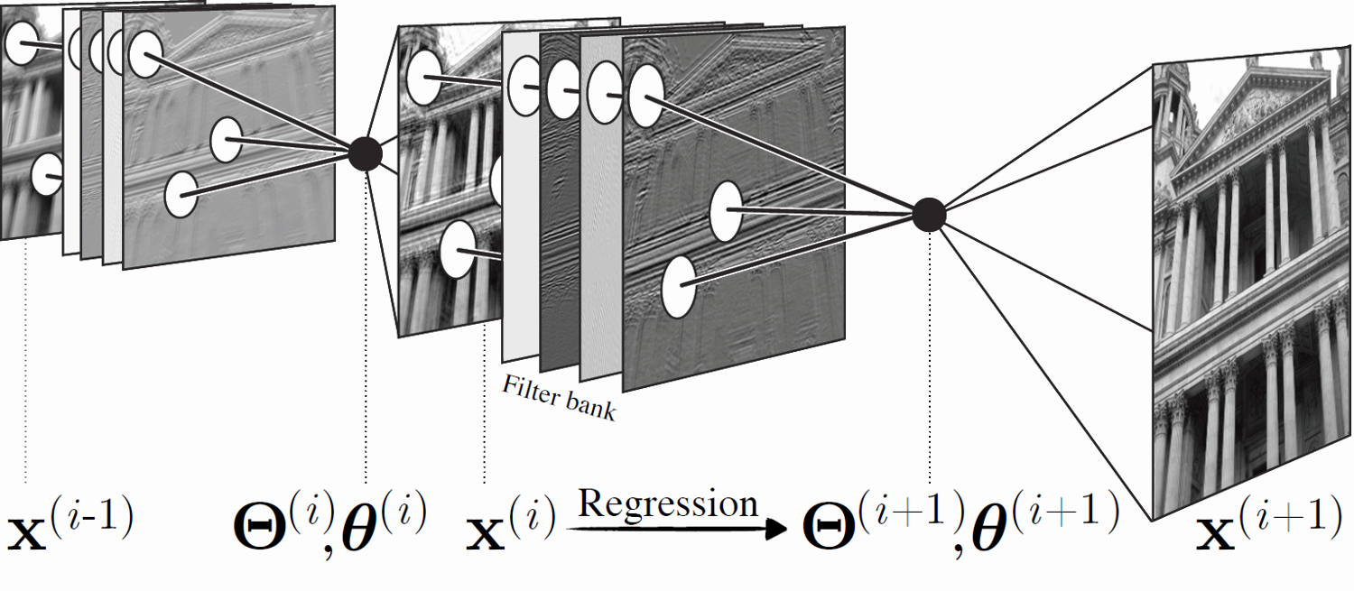
Stacking, Auto-context, Cascades
Learning model with prediction as input
Auto-context (Tu, 2008), (Tu and Bai, 2010)
Regression tree field cascades (Schmidt et al., 2013)
Counter overfitting using stacking
Stacking (Wolpert, 1992), (Munoz et al., 2010)

Slide 10
Perturb-and-MAP
$$\overline{E}\left(y\right)=E\left(y\right)+N(y)$$
$$y^{∗}= {argmin}_{y} \overline{E}(y)$$
Using MAP for defining a model and for inference
Perturb-and-MAP (Papandreou and Yuille, 2011)
Randomized Optimum Models (Tarlow et al., 2012)
Approximate probabilistic inference using MAP (Hazan and Jakkola, 2012)

Slide 11
Joint Inference and Learning
“Approximate inference as a non-linear function”
(Barbu, 2009), (Domke, 2011), (Ross et al., 2011), (Stoyanov et al., 2011)
Consistently better accuracy and speed than classic approach of 1. postulating a model, 2. using approximate inference, 3. doing maximum likelihood estimation
Estimation problem solved using backpropagation (“back mean field”, “back TRW-S”)
Implicitly defined model: no separation between model and inference
Connects inference procedures in graphical models to feed-forward neural networks

Slide 12
Sequential Prediction
Search-based structured prediction, SEARN (Daumé et al., 2009) model prediction as a sequence of conditional decisions, learn policy
Dagger (Ross et al., 2011)
Conditional evaluation of expensive-to-compute features (Weiss and Taskar, 2014)
Connects inference in graphical models to reinforcement learning

Slide 13
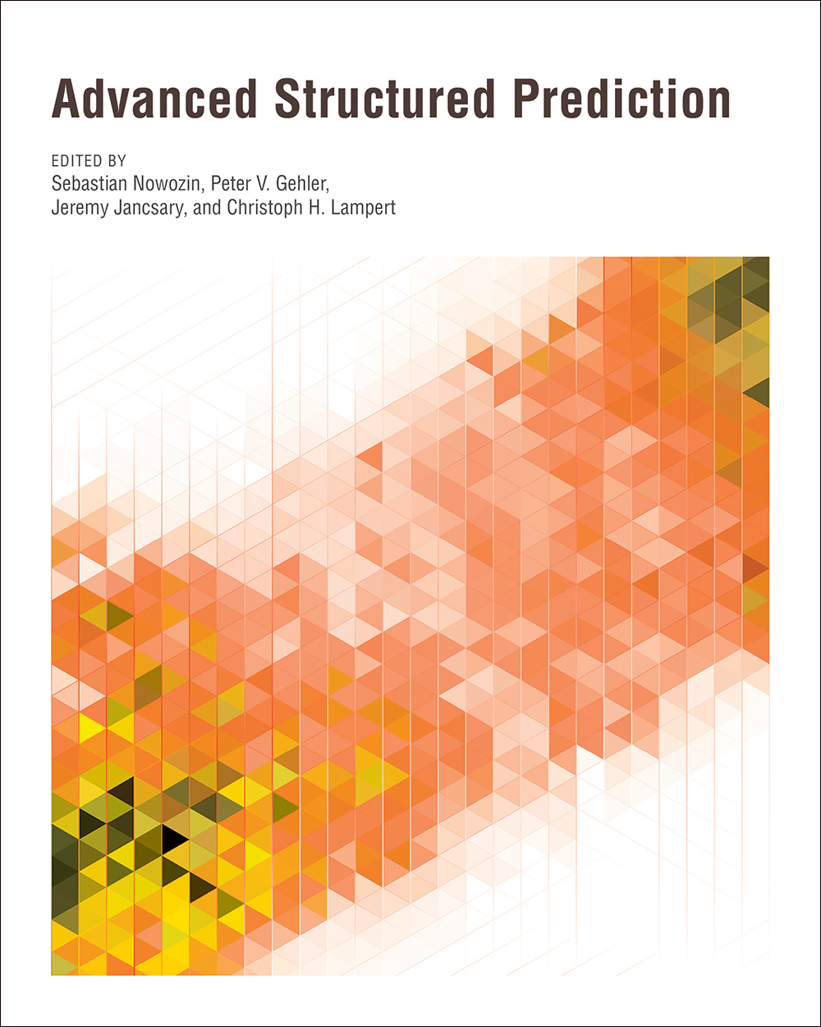
Advanced Structured Prediction
MIT Press edited volume
November 2014
Editors: Sebastian Nowozin, Peter Gehler, Jeremy Jancsary, Christoph Lampert
Contributors
Jonas Behr, Yutian Chen, Fernando De La Torre, Justin Domke, Peter V. Gehler, Andrew E. Gelfand, Sébastien Giguère, Amir Globerson, Fred A. Hamprecht, Minh Hoai, Tommi Jaakkola, Jeremy Jancsary, Joseph Keshet, Marius Kloft, Vladimir Kolmogorov, Christoph H. Lampert, François Laviolette, Xinghua Lou, Mario Marchand, André F. T. Martins, Ofer Meshi, Sebastian Nowozin, George Papandreou, Daniel Průša, Gunnar Rätsch, Amélie Rolland, Bogdan Savchynskyy, Stefan Schmidt, Thomas Schoenemann, Gabriele Schweikert, Ben Taskar, Sinisa Todorovic, Max Welling, David Weiss, Thomáš Werner, Alan Yuille, Stanislav Živný
Notes:
Decision theory: maximize expected utility of decision under your beliefs

Slide 14
Coffee!
Back at 11:10

Slide 15
Coffee!
Back at 16:00

